Slide 1


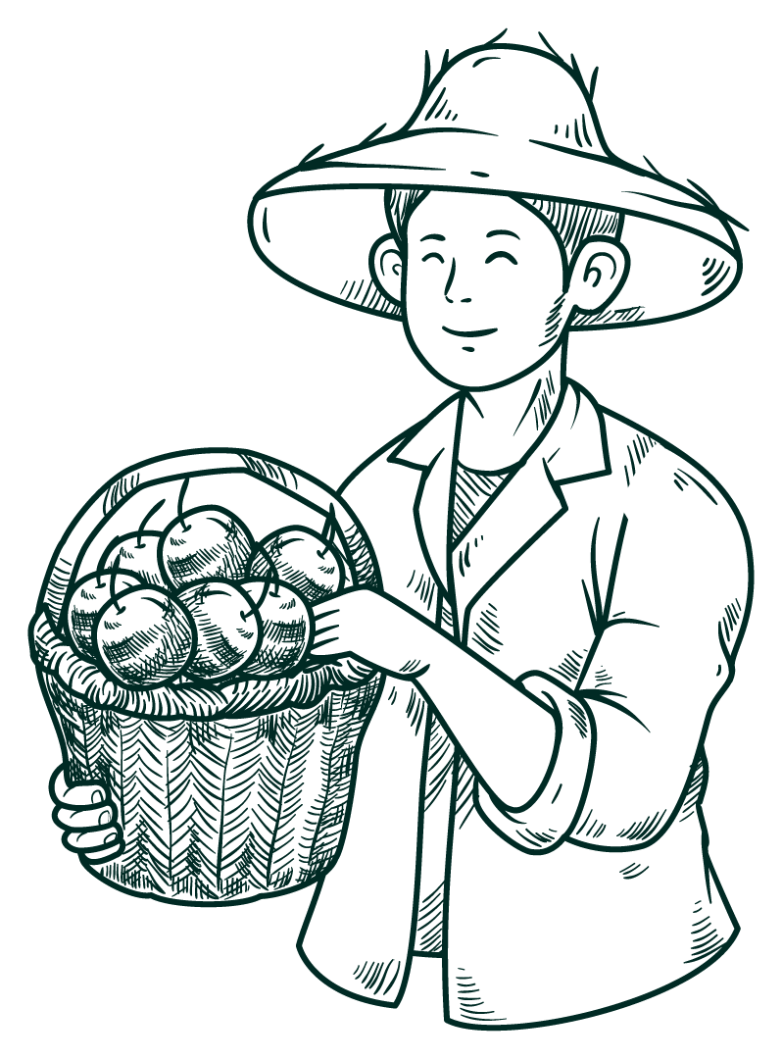



CROP PODUCTION ANALYSIS
If you eat today thank a farmer!

Slide 2
Basic Problem
The business problem described in the text revolves around the need for effective and flexible collaboration among numerous stakeholders in the agri-food sector.
As the agriculture business domain evolves due to advancements in the Future Internet, there is a growing need for a Business-to-Business (B2B) collaboration platform that can facilitate this collaboration.

Slide 3

MAIN KPIs
Top 4 States & Production
Top 4 Crops & Production
Top 4 States & Cultivation Area
Top 4 Districts in a State & Production
Top 4 Districts in a State & Cultivation Area

Slide 4

POWER BI DASHBOARD
If you eat today thank a farmer!

Slide 5
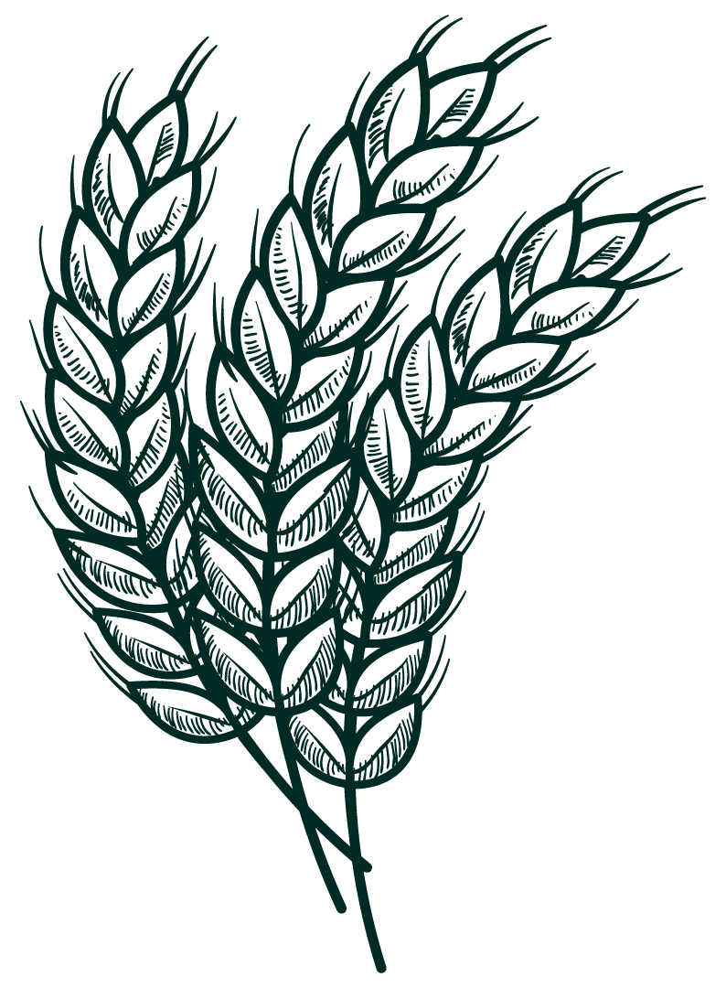


1
State wise data

Slide 6
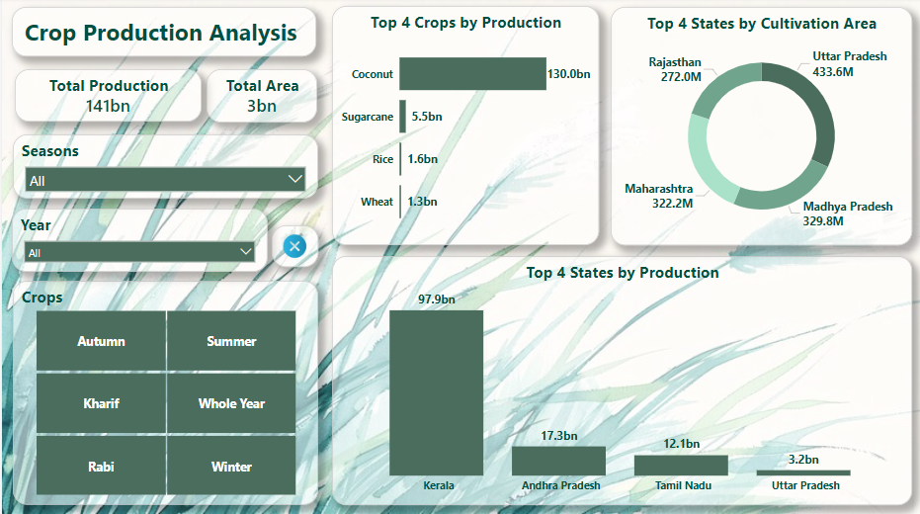

Slide 7
Insights
Total production of Coconut is the Highest among all the crops
Kerla having highest production and cultivation area among all the states.
Maximum production of this crop comes when it is shown in Whole Year season
Total production of Sugarcane is Second Highest among all the crops
Uttar Pradesh having highest production and cultivation area among all the states.
Maximum production of this crop comes when it is shown in Whole Year season.
Total production of Rice is the Third Highest among all the crops
West Bengal having highest production, but cultivation area is highest in Uttar Pradesh.
Maximum production of this crop comes when it is shown in Kharif season
Total production of Wheat is The Fourth Highest among all the crops
Uttar Pradesh having highest production and cultivation area among all the states.
Maximum production of this crop comes when it is shown in Rabi season

Slide 8
2
District wise data

Slide 9
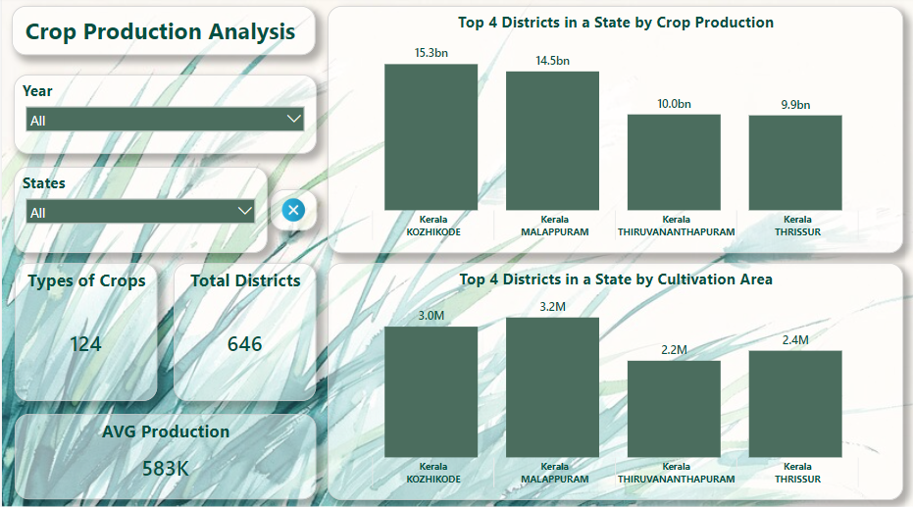

Slide 10
Insights
Top 4 Districts in Production and Cultivation area from Uttar Pradesh.
In every states there are some Districts that dominates the Production and
Cultivation area :-
Uttar Pradesh - In Uttar Pradesh, Bijnor, Kheri, Meerut and Muzaffarnagar.
Bihar - In Bihar, Gopalganj, Pashim & Purbi Champaran and Rohtas.
If the variety of crops are higher in the state that doesn't mean the maximum production will come from the same state.
Karnataka is having highest number of Crops from different variety but maximum production comes from other states. The lowest variety of crops are from Chandigarh.
There are 124 different types of crops that are cultivating in 646 districts of India.
In the year 2011 average production of crops was 1.03 million tones, which is highest in a particular year.

Slide 11
Thank You !
If you eat today thank a farmer!

